Slide 1

Fundamentals of Remote Sensing
MA06186. Term 3
Lead Instructor: Vladimir Gershenzon V.Gershenzon@skoltech.ru
Assistant: Alexander Shumilin
A.Shumilin@skoltech.ru

Slide 2
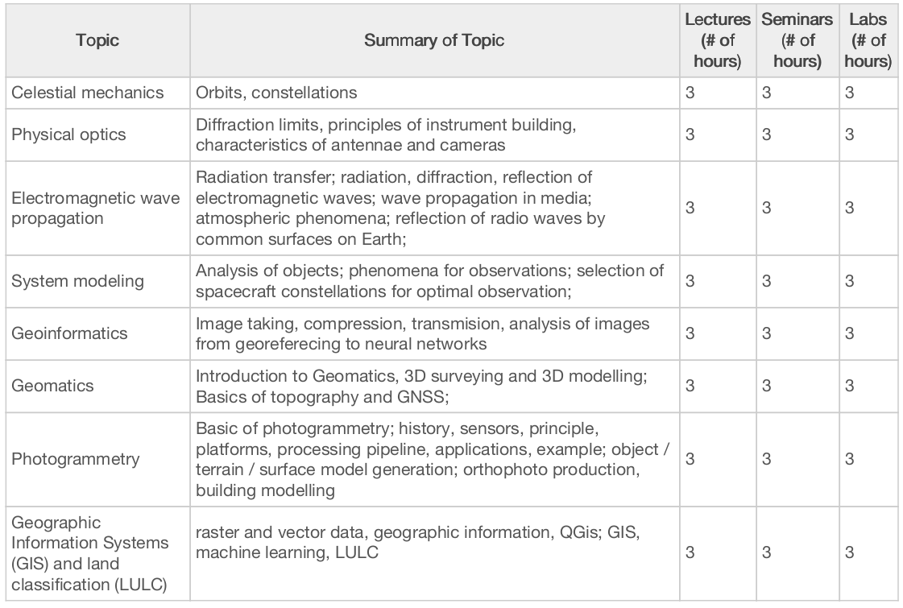

Slide 3

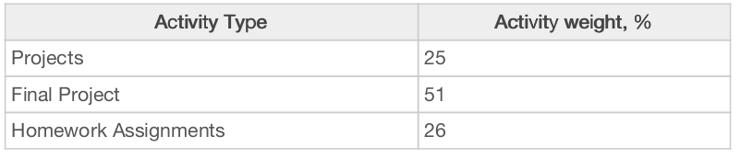
Grading - ?

